Slide 1
Munich Re NatCatSERVICE
Disaster loss data handling & the data landscape
Angelika Wirtz
Munich Re Geo Risks Research
June 2013

Slide 2
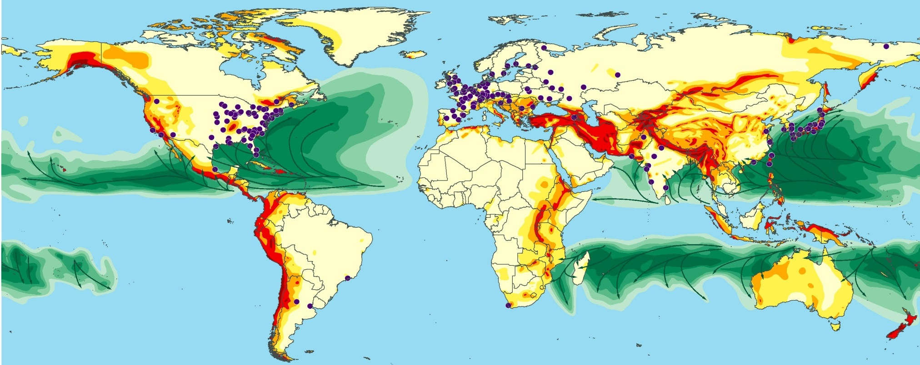
World Map of Natural Hazards
We know and understand risk – it is our business
Munich Re founded 1880 – world leading reinsurance company
branch offices in 60 countries
NatCatSERVICE established 1985 – before paper archive

Slide 3






Munich Re | Head of NatCatSERVICE
 | Chief Editor „Topics Geo“
ICSU-IRDR | Chair of Project „DATA – Disaster Loss Data and Impact Assessment“
ICSU-CoData | Co-Chair of Task Group „Linked Open Data for Global Disaster Risk Research”
WMO World Weather Research Programme | Member of SERA (Working Group on Societal and Economic Research and Applications)

Slide 4

Munich Re | Head of NatCatSERVICE
 | Chief Editor „Topics Geo“
ICSU-IRDR | Chair of Project „DATA – Disaster Loss Data and Impact Assessment“
ICSU-CoData | Co-Chair of Task Group „Linked Open Data for Global Disaster Risk Research”
WMO World Weather Research Programme | Member of SERA (Working Group on Societal and Economic Research and Applications)
Expert on global loss data

Slide 5

Technical Workshop on Standards for Hazard Monitoring,
Databases, Metadata and Analysis Techniques to Support Risk Assessment
The NatCatSERVICE database
Global database – analyses examples
Methodology
The worldwide data landscape
Goals of this workshop
© 2013 Münchener Rückversicherungs-Gesellschaft, Geo Risks Research, NatCatSERVICE

Slide 6
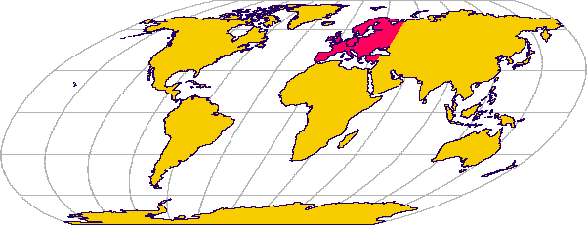
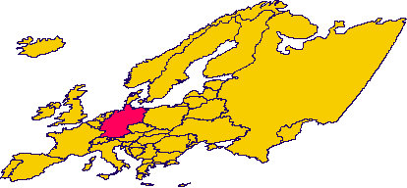
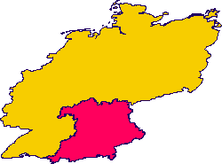
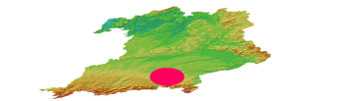
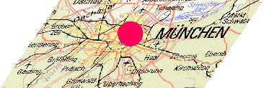

Global vs. local database
global
Munich Re, Swiss Re, CRED Em-Dat
>300 identified country databases
Local databases
local
© 2013 Münchener Rückversicherungs-Gesellschaft, Geo Risks Research, NatCatSERVICE

Slide 7
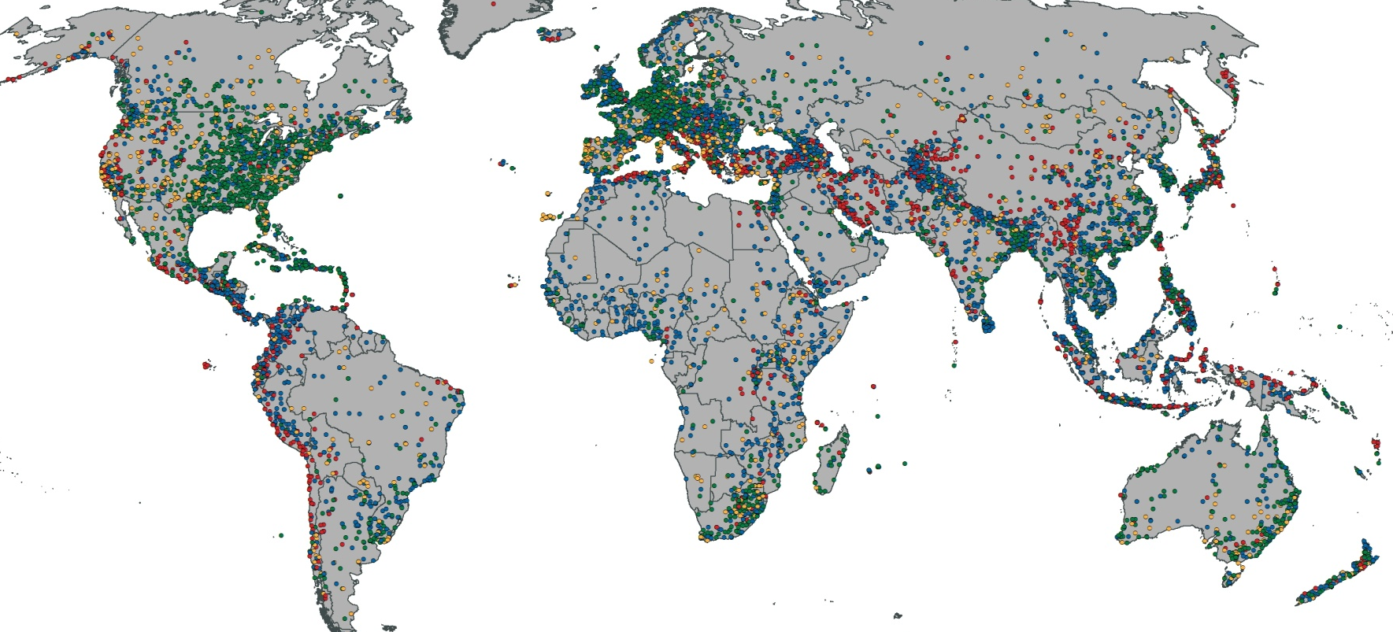
Natural disasters 1980 - 2012
© 2013 Münchener Rückversicherungs-Gesellschaft, Geo Risks Research, NatCatSERVICE

Slide 8
Natural catastrophes worldwide 1980 – 2012
Number of events with trend
NatCatSERVICE
Number
Geophysical events
(Earthquake, tsunami,
volcanic eruption)
Meteorological events
(Storm)
Hydrological events
(Flood, mass movement)
Climatological events
(Extreme temperature,
drought, forest fire)
© 2013 Münchener Rückversicherungs-Gesellschaft, Geo Risks Research, NatCatSERVICE – As at January 2013

Slide 9
Natural catastrophes worldwide 1980 – 2012
Overall and insured losses with trend
(bn US$)
Overall losses (in 2012 values)
Insured losses (in 2012 values)
Trend overall losses
Trend insured losses
© 2013 Münchener Rückversicherungs-Gesellschaft, Geo Risks Research, NatCatSERVICE – As at January 2013

Slide 10
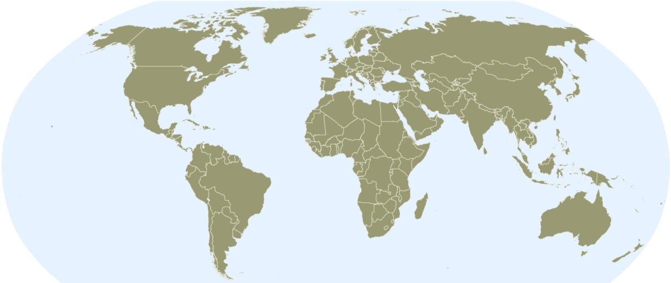
Natural catastrophes worldwide 2012
Overall losses US$ 165bn - Percentage distribution per continent
70%
2012
13%
16%
14%
42%
1980-2011
40%
<1%
1%
<1%
3%
Continent | Overall losses US$ m
America (North and South America) | 115,000
Europe | 21,000
Africa | 1,000
Asia | 26,000
Australia/Oceania | 1,000
© 2013 Münchener Rückversicherungs-Gesellschaft, Geo Risks Research, NatCatSERVICE – As at January 2013

Slide 11
Natural catastrophes worldwide 1980 – 2011
Losses as a ratio of GDP
(% of GDP affected )
High income economies
Income Groups 2012 (defined by World Bank):
High income economies
Upper middle income economies
Lower middle income economies
Low income economies
(GNI > 12,476 US$)
(GNI 4,036 – 12,475 US$)
(GNI 1,026 – 4,035 US$)
(GNI < 1,025 US$)
© 2013 Münchener Rückversicherungs-Gesellschaft, Geo Risks Research, NatCatSERVICE

Slide 12
Natural catastrophes worldwide 1980 – 2011
Losses as a ratio of GDP
(% of GDP affected )
Upper middle income economies
Income Groups 2012 (defined by World Bank):
High income economies
Upper middle income economies
Lower middle income economies
Low income economies
(GNI > 12,476 US$)
(GNI 4,036 – 12,475 US$)
(GNI 1,026 – 4,035 US$)
(GNI < 1,025 US$)
© 2013 Münchener Rückversicherungs-Gesellschaft, Geo Risks Research, NatCatSERVICE

Slide 13
Natural catastrophes worldwide 1980 – 2011
Losses as a ratio of GDP
(% of GDP affected )
Lower middle income economies
Income Groups 2012 (defined by World Bank):
High income economies
Upper middle income economies
Lower middle income economies
Low income economies
(GNI > 12,476 US$)
(GNI 4,036 – 12,475 US$)
(GNI 1,026 – 4,035 US$)
(GNI < 1,025 US$)
© 2013 Münchener Rückversicherungs-Gesellschaft, Geo Risks Research, NatCatSERVICE

Slide 14
Natural catastrophes worldwide 1980 – 2011
Losses as a ratio of GDP
(% of GDP affected )
11,5%
Low income economies
Income Groups 2012 (defined by World Bank):
High income economies
Upper middle income economies
Lower middle income economies
Low income economies
(GNI > 12,476 US$)
(GNI 4,036 – 12,475 US$)
(GNI 1,026 – 4,035 US$)
(GNI < 1,025 US$)
© 2013 Münchener Rückversicherungs-Gesellschaft, Geo Risks Research, NatCatSERVICE

Slide 15




Global databases in dialog
CRED
UNDP
Asia Disaster Reduction
Center
DesInventar
UN-ISDR
© 2013 Münchener Rückversicherungs-Gesellschaft, Geo Risks Research, NatCatSERVICE

Slide 16


Disaster loss data
Overview of global databases – entry criteria
CRED
NatCatSERVICE
EM-DAT
Sigma
Criteria*:
Property damage
People killed
People injured
Criteria*:
≥10 people killed
≥100 people affected
Declaration of a state of
emergency/ Call for
international assistance
Criteria*:
>20 people killed
>50 people injured
>2,000 homeless
Insured losses **:
>US$ 14m (Marine)
>US$ 28m (Aviation)
>US$ 35m (all other losses)
Overall losses **:
>US$ 70m
* Criteria for a disaster to be entered into the databases. (At least one of the criteria has to be fulfilled.)
** Entry criteria of losses are adjusted to inflation every year.
© 2013 Münchener Rückversicherungs-Gesellschaft, Geo Risks Research, NatCatSERVICE

Slide 17
Structure – peril families
Family
Main event
Sub Peril
Geophysical
Earthquake
Volcanic eruption
Mass movement dry
EQ Ground shaking
Fire following
Tsunami
Meteorological
Hydrological
Subsidence
Liquefaction
Rockfall
Landslide
Climatological
© 2013 Münchener Rückversicherungs-Gesellschaft, Geo Risks Research, NatCatSERVICE

Slide 18
Structure – peril families
Family
Main event
Sub Peril
Geophysical
Tropical cyclone
Extra tropical cyclone (winter storm)
Convective storms
(thunderstorm, hail
lightning, tornado)
Local windstorm (orographic storm)
Sandstorm/Dust storm
Blizzard/Snowstorm
Meteorological
Storm
Hydrological
Climatological
© 2013 Münchener Rückversicherungs-Gesellschaft, Geo Risks Research, NatCatSERVICE

Slide 19
Structure – peril families
Family
Main event
Sub Peril - examples
Geophysical
General / River flood
Flash flood
Storm surge
Glacial lake outburst flood
Meteorological
Hydrological
Flood
Mass movement wet
Climatological
Subsidence
Avalanche
Landslide
© 2013 Münchener Rückversicherungs-Gesellschaft, Geo Risks Research, NatCatSERVICE

Slide 20
Structure – peril families
Family
Main event
Sub Peril
Geophysical
Heat wave
Cold wave / frost
Extreme winter conditions
Meteorological
Hydrological
Drought
Climatological
Extreme temperature
Drought
Wildfire
Forest / grassland fire
© 2013 Münchener Rückversicherungs-Gesellschaft, Geo Risks Research, NatCatSERVICE

Slide 21
Structure – peril families
Family
Main event
Sub Peril
Associated
Cascading
Sub-sub peril
Geophysical
Heat wave
Cold wave / frost
Extreme winter conditions
Meteorological
Hydrological
Drought
Famine
Climatological
Extreme temperature
Drought
Wildfire
Forest / grassland fire
© 2013 Münchener Rückversicherungs-Gesellschaft, Geo Risks Research, NatCatSERVICE

Slide 22
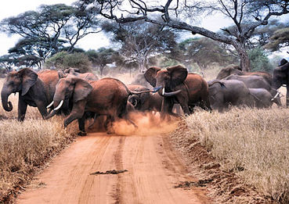
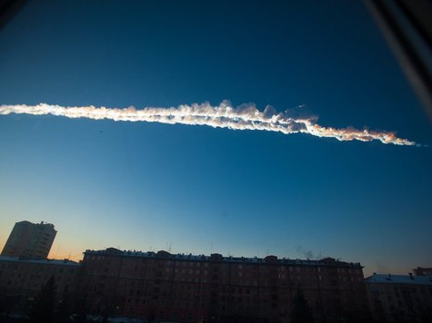

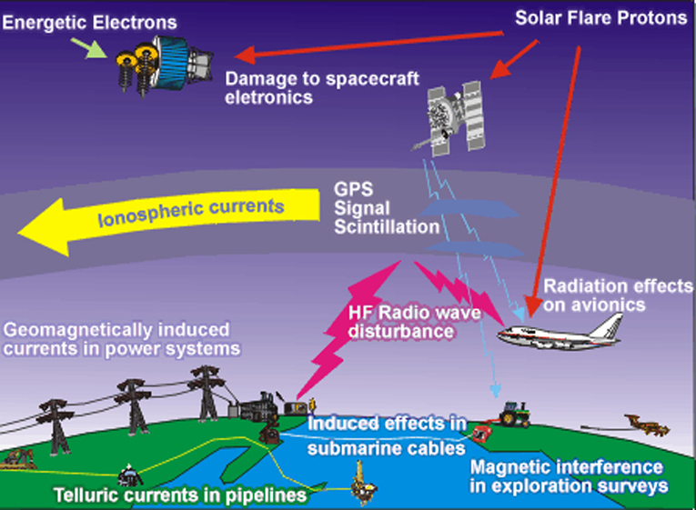
Structure – peril families
Family
Geophysical
Meteorological
Hydrological
Climatological
Biological
Extra-Terrestrial
© 2013 Münchener Rückversicherungs-Gesellschaft, Geo Risks Research, NatCatSERVICE

Slide 23
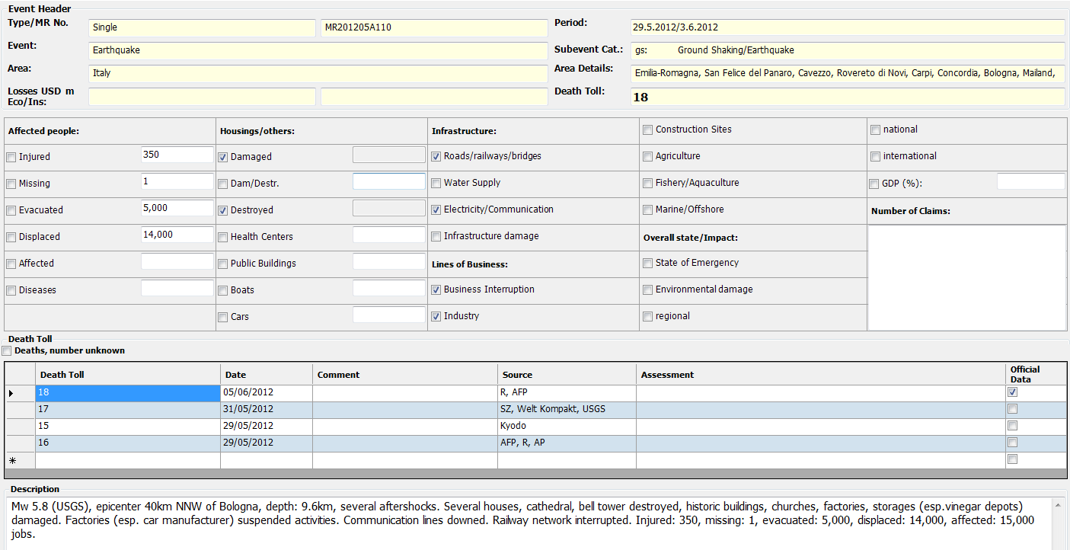
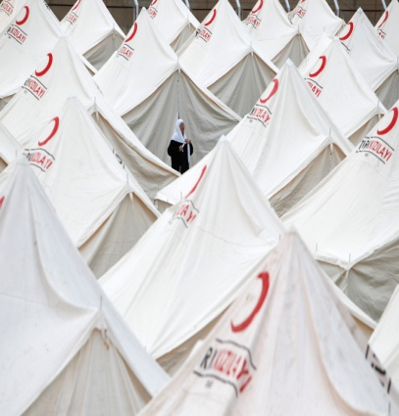
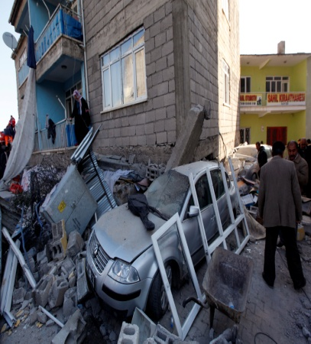
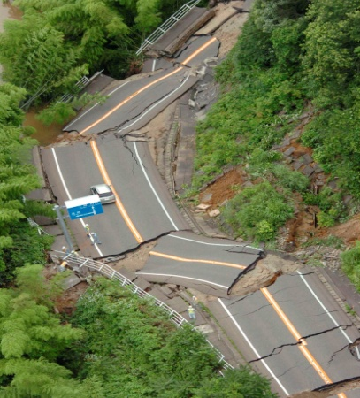
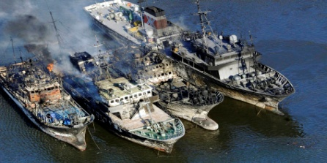

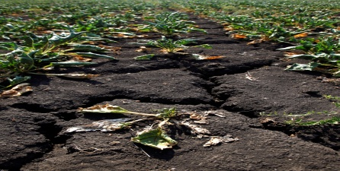
Meta information
Loss and damage (monetary and human impact)
© 2013 Münchener Rückversicherungs-Gesellschaft, Geo Risks Research, NatCatSERVICE

Slide 24
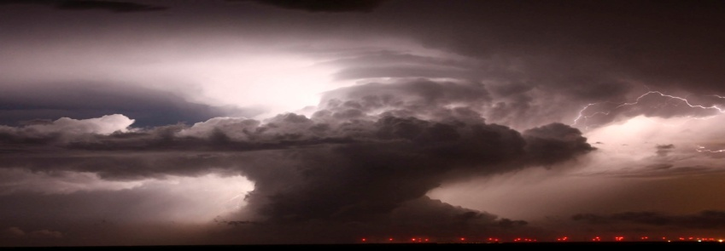
Meta information
Scientific parameter
Start and end day / duration
Geographic information (continent ......village.....addresse)
etc.

Slide 25
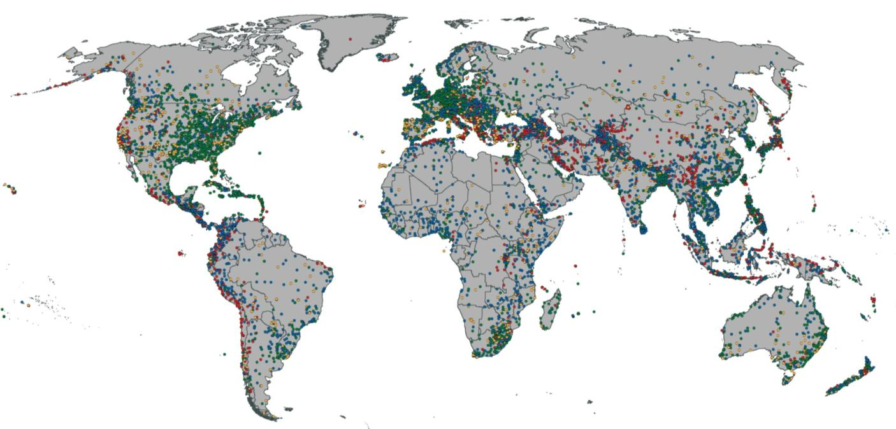
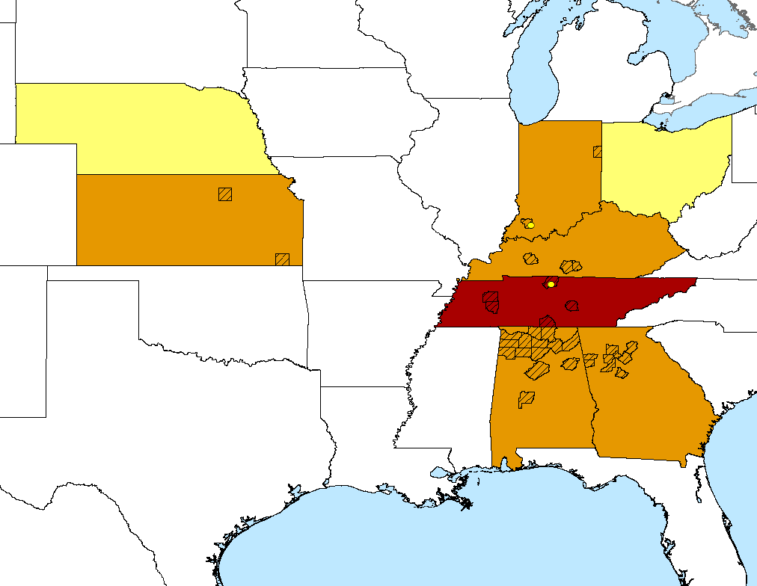
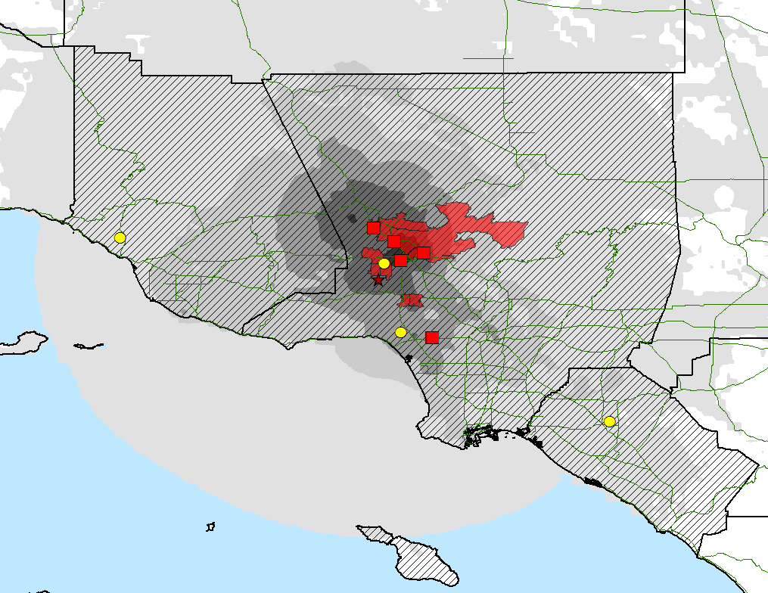
Geocoding
From global to national to footprint
NE
IN
OH
KS
KY
TN
Los Angeles
© 2013 Münchener Rückversicherungs-Gesellschaft, Geo Risks Research, NatCatSERVICE

Slide 26
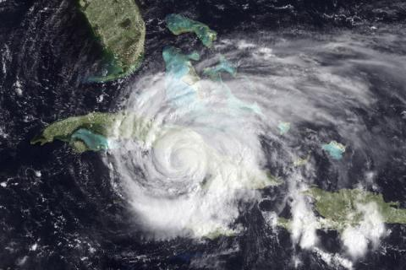
Multi-country event
© 2013 Münchener Rückversicherungs-Gesellschaft, Geo Risks Research, NatCatSERVICE

Slide 27
Multi-country event
Hurricane Ike
USA
Cuba
Turks & Caicos
Dom. Rep
Haiti
Bahamas
Region
Details
Damages
Region
Details
Damages
Region
Details
Damages
Region
Details
Damages
Region
Details
Damages
Region
Details
Damages
© 2013 Münchener Rückversicherungs-Gesellschaft, Geo Risks Research, NatCatSERVICE

Slide 28
Multi-peril event
Typhoon
Flood
Landslide
Tornado
Affected region
Scientific details
Damage
Affected people
Affected region
Scientific details
Damage
Affected people
Affected region
Scientific details
Damage
Affected people
© 2013 Münchener Rückversicherungs-Gesellschaft, Geo Risks Research, NatCatSERVICE

Slide 29

What exactly is disaster loss data
© 2013 Münchener Rückversicherungs-Gesellschaft, Geo Risks Research, NatCatSERVICE

Slide 30
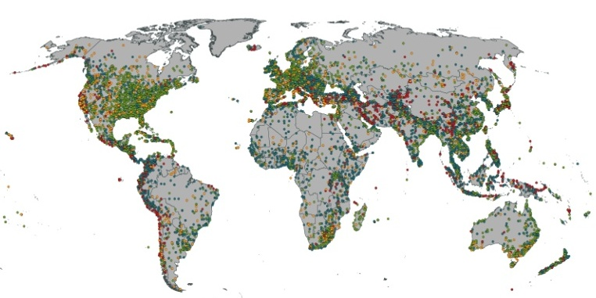
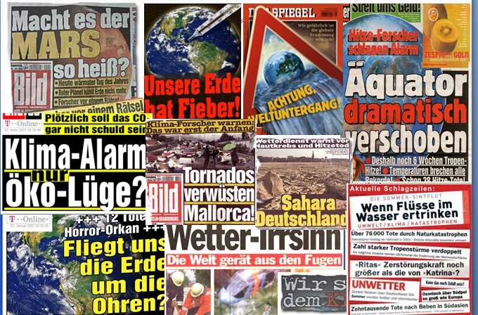
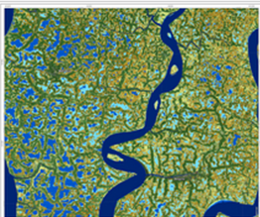
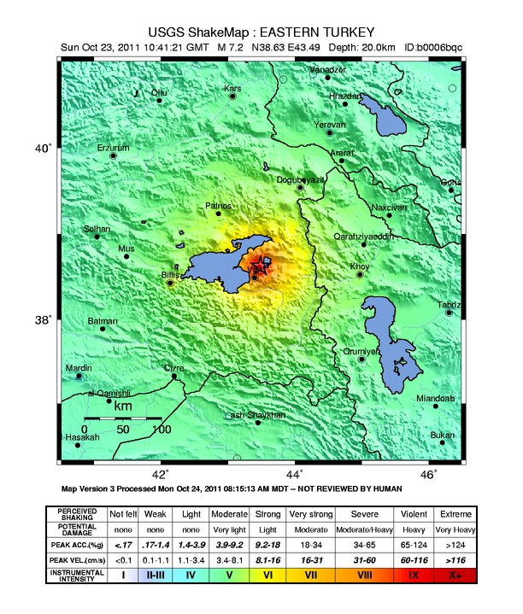
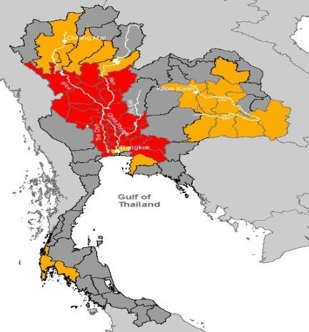
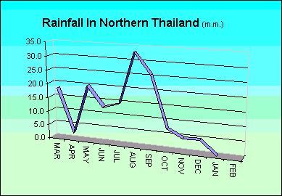
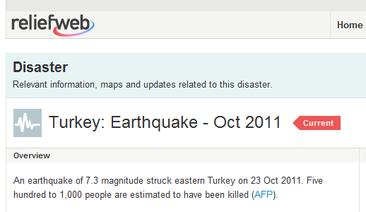
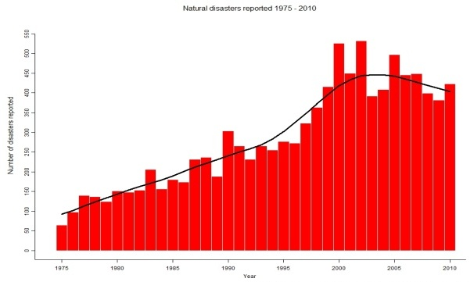
Disaster Loss Data
EM-DAT

Slide 31
Disaster loss data
Overview of stakeholders
Data providers
overlaps
Data collectors
Data platforms
Data users
© 2013 Münchener Rückversicherungs-Gesellschaft, Geo Risks Research, NatCatSERVICE

Slide 32
Disaster loss data
Overview of data providers - examples
Kind of data | Example Information | Example Data Providers
General informaion | Description of event | Media, satellite images, case studies
Scientific information | Precipitation, magnitude | Scientific institutes (Weather services, USGS)
Human impact | People affected, injured, death, missing | Aid organisations, like Relief Web, IFRC
Monetary loss information
- Economic loss | Financial impact of disaster (direct loss, indirect loss, secondary loss) | Different organisations (governments, World Bank,ECLAC, professional loss provider, etc)
- Insured loss | Regional, national, local loss | Reinsurance, insurance associations, local insurance, professional loss provider
 | Sector based national loss | NFIP (flood), USDA (agro)
Automatic generated information | Region affected, people involved | Joint Research Centre/GDACS, USGS-Pager
© 2013 Münchener Rückversicherungs-Gesellschaft, Geo Risks Research, NatCatSERVICE

Slide 33
Disaster loss data
Overview of data providers - examples
Kind of data | Example Information | Example Data Providers
General informaion | Description of event | Media, satellite images, case studies
Scientific information | Precipitation, magnitude | Scientific institutes (Weather services, USGS)
Human impact | People affected, injured, death, missing | Aid organisations, like Relief Web, IFRC
Monetary loss information
- Economic loss | Financial impact of disaster (direct loss, indirect loss, secondary loss) | Different organisations (governments, World Bank,ECLAC, professional loss provider, etc)
- Insured loss | Regional, national, local loss | Reinsurance, insurance associations, local insurance, professional loss provider
 | Sector based national loss | NFIP (flood), USDA (agro)
Automatic generated information | Region affected, people involved | Joint Research Centre/GDACS, USGS-Pager
© 2013 Münchener Rückversicherungs-Gesellschaft, Geo Risks Research, NatCatSERVICE

Slide 34
Disaster loss data
Overview of data providers - examples
Kind of data | Example Information | Example Data Providers
General informaion | Description of event | Media, satellite images, case studies
Scientific information | Precipitation, magnitude | Scientific institutes (Weather services, USGS)
Human impact | People affected, injured, death, missing | Aid organisations, like Relief Web, IFRC
Monetary loss information
- Economic loss | Financial impact of disaster (direct loss, indirect loss, secondary loss) | Different organisations (governments, World Bank,ECLAC, professional loss provider, etc)
- Insured loss | Regional, national, local loss | Reinsurance, insurance associations, local insurance, professional loss provider
 | Sector based national loss | NFIP (flood), USDA (agro)
Automatic generated information | Region affected, people involved | Joint Research Centre/GDACS, USGS-Pager
© 2013 Münchener Rückversicherungs-Gesellschaft, Geo Risks Research, NatCatSERVICE

Slide 35
Disaster loss data
Overview of data providers - examples
Kind of data | Example Information | Example Data Providers
General informaion | Description of event | Media, satellite images, case studies
Scientific information | Precipitation, magnitude | Scientific institutes (Weather services, USGS)
Human impact | People affected, injured, death, missing | Aid organisations, like Relief Web, IFRC
Monetary loss information
- Economic loss | Financial impact of disaster (direct loss, indirect loss, secondary loss) | Different organisations (governments, World Bank,ECLAC, professional loss provider, etc)
- Insured loss | Regional, national, local loss | Reinsurance, insurance associations, local insurance, professional loss provider
 | Sector based national loss | NFIP (flood), USDA (agro)
Automatic generated information | Region affected, people involved | Joint Research Centre/GDACS, USGS-Pager
© 2013 Münchener Rückversicherungs-Gesellschaft, Geo Risks Research, NatCatSERVICE

Slide 36
Disaster loss data
Overview of data providers - examples
Kind of data | Example Information | Example Data Providers
General informaion | Description of event | Media, satellite images, case studies
Scientific information | Precipitation, magnitude | Scientific institutes (Weather services, USGS)
Human impact | People affected, injured, death, missing | Aid organisations, like Relief Web, IFRC
Monetary loss information
- Economic loss | Financial impact of disaster (direct loss, indirect loss, secondary loss) | Different organisations (governments, World Bank,ECLAC, professional loss provider, etc)
- Insured loss | Regional, national, local loss | Reinsurance, insurance associations, local insurance, professional loss provider
 | Sector based national loss | NFIP (flood), USDA (agro)
Automatic generated information | Region affected, people involved | Joint Research Centre/GDACS, USGS-Pager
© 2013 Münchener Rückversicherungs-Gesellschaft, Geo Risks Research, NatCatSERVICE

Slide 37
Disaster loss data
Overview of data providers - examples
Kind of data | Example Information | Example Data Providers
General informaion | Description of event | Media, satellite images, case studies
Scientific information | Precipitation, magnitude | Scientific institutes (Weather services, USGS)
Human impact | People affected, injured, death, missing | Aid organisations, like Relief Web, IFRC
Monetary loss information
- Economic loss | Financial impact of disaster (direct loss, indirect loss, secondary loss) | Different organisations (governments, World Bank,ECLAC, professional loss provider, etc)
- Insured loss | Regional, national, local loss | Reinsurance, insurance associations, local insurance, professional loss provider
 | Sector based national loss | NFIP (flood), USDA (agro)
Automatic generated information | Region affected, people involved | Joint Research Centre/GDACS, USGS-Pager
© 2013 Münchener Rückversicherungs-Gesellschaft, Geo Risks Research, NatCatSERVICE

Slide 38
Disaster loss data
Overview of data providers - examples
Kind of data | Example Information | Example Data Providers
General informaion | Description of event | Media, satellite images, case studies
Scientific information | Precipitation, magnitude | Scientific institutes (Weather services, USGS)
Human impact | People affected, injured, death, missing | Aid organisations, like Relief Web, IFRC
Monetary loss information
- Economic loss | Financial impact of disaster (direct loss, indirect loss, secondary loss) | Different organisations (governments, World Bank,ECLAC, professional loss provider, etc)
- Insured loss | Regional, national, local loss | Reinsurance, insurance associations, local insurance, professional loss provider
 | Sector based national loss | NFIP (flood), USDA (agro)
Automatic generated information | Region affected, people involved | Joint Research Centre/GDACS, USGS-Pager
© 2013 Münchener Rückversicherungs-Gesellschaft, Geo Risks Research, NatCatSERVICE

Slide 39
Disaster loss data
Overview of data collectors - examples
Kind of data | Examples Data Collectors | Comments
Global multi peril | EmDat, Munich Re, Swiss Re
Regional multi peril | La Red EEA European Environmental Agency | In planning
National multi peril | UNDP (country databases after TS 2004), Sheldus
Event based | Dartmouth Flood Observatory CEDIM Center for Disaster Management and Risk Reduction Technology | Flood Earthquakes, Landslides
Sector based | Ascend USDA (US Dept. of Agriculture) | Aviation Agriculture
© 2013 Münchener Rückversicherungs-Gesellschaft, Geo Risks Research, NatCatSERVICE

Slide 40
Disaster loss data
Overview of data collectors - examples
Kind of data | Examples Data Collectors | Comments
Global multi peril | EmDat, Munich Re, Swiss Re
Regional multi peril | La Red EEA European Environmental Agency | In planning
National multi peril | UNDP (country databases after TS 2004), Sheldus
Event based | Dartmouth Flood Observatory CEDIM Center for Disaster Management and Risk Reduction Technology | Flood Earthquakes, Landslides
Sector based | Ascend USDA (US Dept. of Agriculture) | Aviation Agriculture
© 2013 Münchener Rückversicherungs-Gesellschaft, Geo Risks Research, NatCatSERVICE

Slide 41
Disaster loss data
Overview of data collectors - examples
Kind of data | Examples Data Collectors | Comments
Global multi peril | EmDat, Munich Re, Swiss Re
Regional multi peril | La Red EEA European Environmental Agency | In planning
National multi peril | Sheldus UNDP (country databases after TS 2004)
Event based | Dartmouth Flood Observatory CEDIM Center for Disaster Management and Risk Reduction Technology | Flood Earthquakes, Landslides
Sector based | Ascend USDA (US Dept. of Agriculture) | Aviation Agriculture
© 2013 Münchener Rückversicherungs-Gesellschaft, Geo Risks Research, NatCatSERVICE

Slide 42
Disaster loss data
Overview of data collectors - examples
Kind of data | Examples Data Collectors | Comments
Global multi peril | EmDat, Munich Re, Swiss Re
Regional multi peril | La Red EEA European Environmental Agency | In planning
National multi peril | UNDP (country databases after TS 2004), Sheldus
Event based | Dartmouth Flood Observatory CEDIM Center for Disaster Management and Risk Reduction Technology | Flood Earthquakes, Landslides
Sector based | Ascend USDA (US Dept. of Agriculture) | Aviation Agriculture
© 2013 Münchener Rückversicherungs-Gesellschaft, Geo Risks Research, NatCatSERVICE – As at January 2013

Slide 43
Disaster loss data
Overview of data collectors - examples
Kind of data | Examples Data Collectors | Comments
Global multi peril | EmDat, Munich Re, Swiss Re
Regional multi peril | La Red EEA European Environmental Agency | In planning
National multi peril | Sheldus, UNDP (country databases after TS 2004)
Event based | Dartmouth Flood Observatory CEDIM Center for Disaster Management and Risk Reduction Technology | Flood Earthquakes, Landslides
Sector based | Ascend USDA (US Dept. of Agriculture) | Aviation Agriculture
© 2013 Münchener Rückversicherungs-Gesellschaft, Geo Risks Research, NatCatSERVICE

Slide 44
Disaster loss data
Overview of data users - examples
Sector |  | Examples
Science | Research projects | Trend analyses, IPCC, Global Assessment Report, GEM
Decision makers | Governments, NGOs | Loss reduction purposes, risk reduction measurements
Finance industry | Insurance | Risk calculation, development of new solutions, Microinsurance schemes, government schemes
 | Alternative (monetary) risk transfers | Cat Bonds, weather derivate
 | Modelling companies (RMS, EQE Cat, AIR) | Calibrate models
Media
© 2013 Münchener Rückversicherungs-Gesellschaft, Geo Risks Research, NatCatSERVICE

Slide 45
The ideal world of disaster loss data
Scientific data
Global databases
Local databases
National and regional databases
Literature:
Forensic case studies
Scientific analyses
WORLD DATA ORGANISATION / PLATFORM
with Meta-Data and links to specialized data provider
GLIDE
Funding organisations
Local Decision Makers
Governments
Insurance industry
Finance industry
NGOs
© 2013 Münchener Rückversicherungs-Gesellschaft, Geo Risks Research, NatCatSERVICE

Slide 46
Projects and initiatives
Examples
ICSU – IRDR Project „DATA – Disaster Loss Data and Impact Assessment“
CRED – Harmonisation of human and economic loss indicators
ICSU – CoDATA – Working & Task Force Group on disaster data
European Commission – Standards and protocols for recording losses, recommendations for a European approach
© 2013 Münchener Rückversicherungs-Gesellschaft, Geo Risks Research, NatCatSERVICE

Slide 47

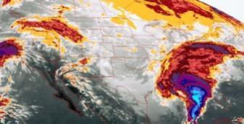


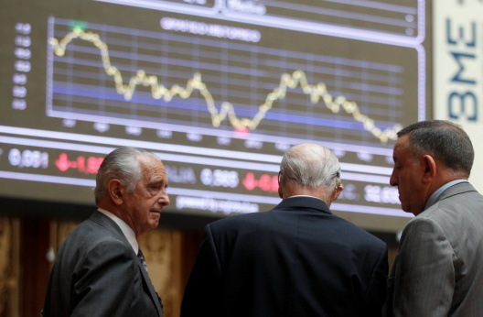

Science
Political committees
Clients
Analysts, investors
Media
IRDR – Integrated Research on Disaster Risk Science Plan
Objective 3: Reducing Risk and Curbing Losses Through Knowlede-Based Actions
Disaster loss data are necessary to improve integrated disaster risk management

Slide 48
IRDR – Integrated Research on Disaster Risk
Project: DATA - Disaster Loss Data and Impact Assessment
Objectives
Identify what data and quality are needed to improve integrated disaster risk management
Bring together loss data stakeholders and utilize synergies
Have recognized standards, minimize uncertainty
Education of users regarding data interpretation and data biases
Ensure increased downscaling of loss data to sub-national geographies for policy makers
Definition of "losses" and creation of a methodology for assessing it
© 2013 Münchener Rückversicherungs-Gesellschaft, Geo Risks Research, NatCatSERVICE

Slide 49
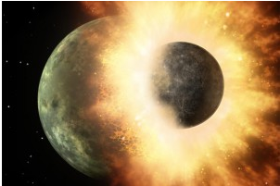
Objective of this workshop

Slide 50
Challenge
Bring different world together without a collission
Meteorological/hydrological/climate-related data | Precipitation
 | Water levels
 | Soil conditions
 | Wind speeds, gusts
 | Storm tracks, landfall information

Slide 51
Challenge
Bring different world together without a collission
Risk analysis data | Hazard information
 | Exposure to risk housing stock, capital stock, GDP, Population (per country/grid)
 | Social Vulnerability information
 | Reselience level
 | Agriculture GDP /rural vs. urban population
 | Etc.

Slide 52
Challenge
Bring different world together without a collission
Damage and loss data | Impact on people
 | Damage on housings, property (cars, boats)
 | Infrastructure / critical infrastructure
 | Sectors (health, agriculture, small businesses...)
 | Economic impact (direct/indirect/secondary loss) -currencies-
 | Satelite images (before and after)
 | Location - Geocoding
 | Forensic studies / case studies / lessons learned

Slide 53
Challenge
Bring different worlds together without a collission
Met-Offices
Damage and Loss
Risk analysis data
Risk Analysis and Disaster Risk Assessment
Goal: to minimize losses (human, monetary)
to improve preparedness measurements
to improve early warning
to improve estisting infrastructure

Slide 54
Challenge
Bring different worlds together without a collission
Different wordings / terminologies (i.e. hazard)
Different users and requirements
Different definitions (i.e. extreme event, natural event)
Different hazard types
Met-Data
Damage and Loss
Risk analysis data
Risk Analysis and Disaster Risk Assessment
Goal: to minimize losses (human, monetary)
to improve preparedness measurements
to improve early warning
to improve estisting infrastructure

Slide 55
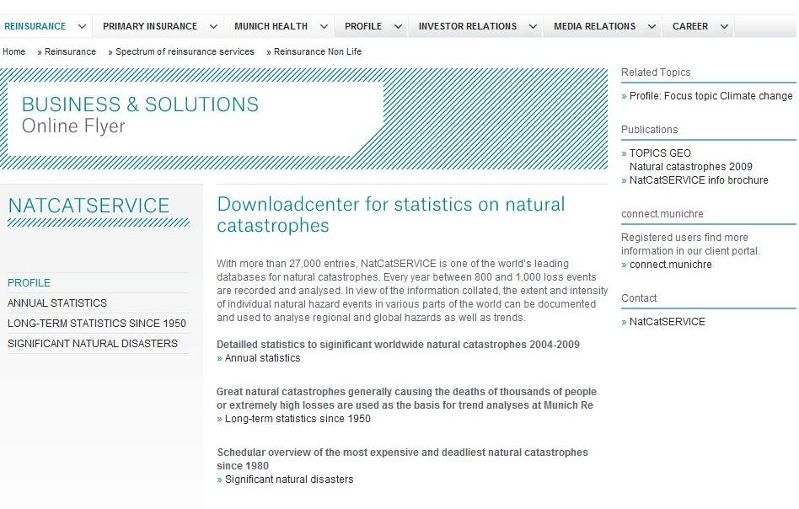
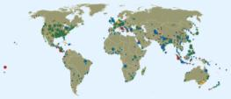
NatCatSERVICE
Download-Center
www.munichre.com/natcatservice/downloadcenter
© 2013 Münchener Rückversicherungs-Gesellschaft, Geo Risks Research, NatCatSERVICE – As at January 2013

Slide 56

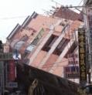
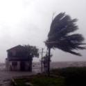
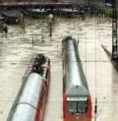
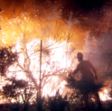
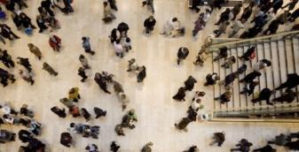
NatCatSERVICE User
Clients
Analysts, investors
Munich Re Group
Science
NatCatSERVICE
General public
Political committees
Media
© 2012 Münchener Rückversicherungs-Gesellschaft, Geo Risks Research, NatCatSERVICE

Slide 57

Thank you
Angelika Wirtz
Geo Risks Research/Corporate Climate Centre
Munich Re

